Slide 1
AUTOMATIC TICKET DISTRIBUTER
TEAM
MEMBERS
GUIDED BY :
GUIDED BY :
HARIKUMARESAN .S
JAISURYA.S
GUHANRAJ .P.K
MAHENDRAN .V
Mr.P.T.SIVAGURUNATHAN
(Assistant professor)

Slide 2
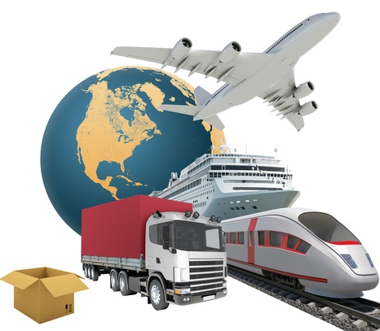
TRANSPORTS:
What do you mean of transport?
It is the way a person/object is moved from one place to another. Modes of transport include water, air, land (rail and road), cable, pipeline and space.

Slide 3
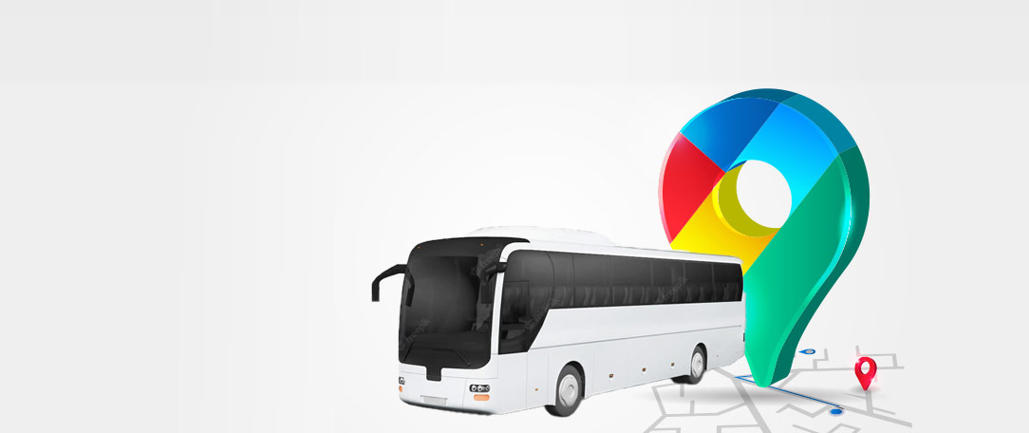
BUS Transportation
What is bus in transportation?
A bus (contracted from omnibus, with variants multibus, motorbus, autobus, etc.) is a road vehicle that carries significantly more passengers than an average car or van. It is most commonly used in public transport, but is also in use for charter purposes, or through private ownership.

Slide 4
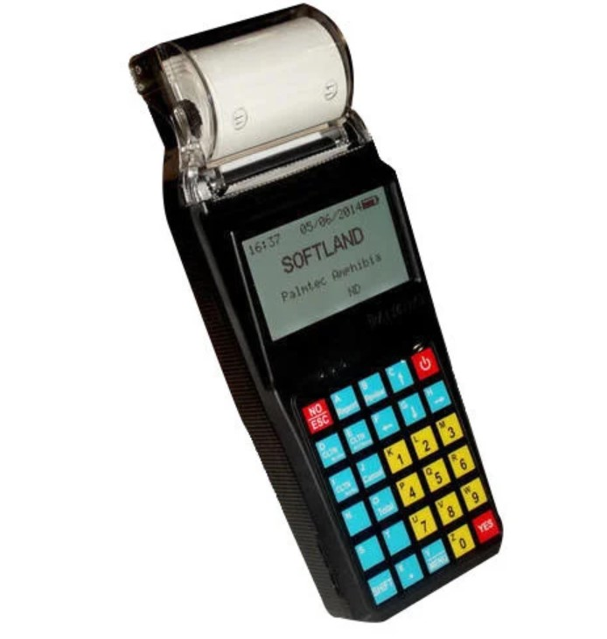
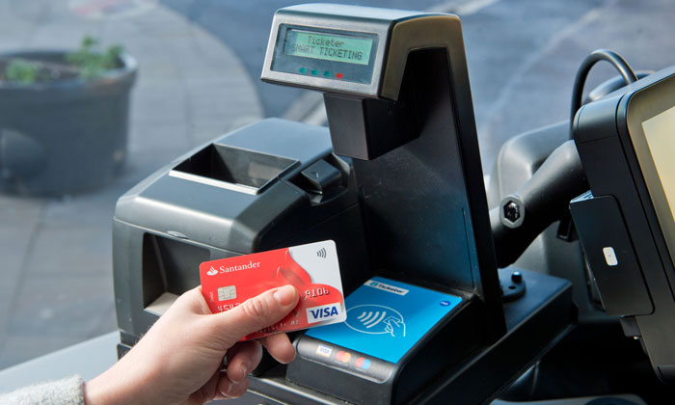
ABOUT
AUTOMATIC TICKET DISTRIBUTER
Old method:
New method:

Slide 5
PURPOSE :
To make the Travel comfortable by providing the Ticket digitally which replaces the work of the Conductor .

Slide 6
COMPONENTS
ARDUINO UNO
LCD DISPLAY
RFID CHIP
RFID READ/WRITER
SIM MODULE

Slide 7
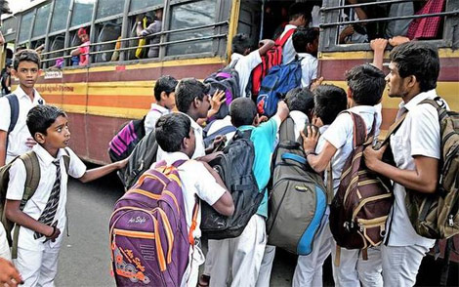
Normal days:
A typical urban bus will carry approximately 40 passengers seated and 30 standing; if all buses are of this configuration the percent seated capacity for the fleet will be approximately 60%. Some buses, particularly those used on premium quality services, carry 100% seated passengers.

Slide 8
1
Place the card
For verification
2
Select the place
User to move
3
Payment
Message to the user

Slide 9
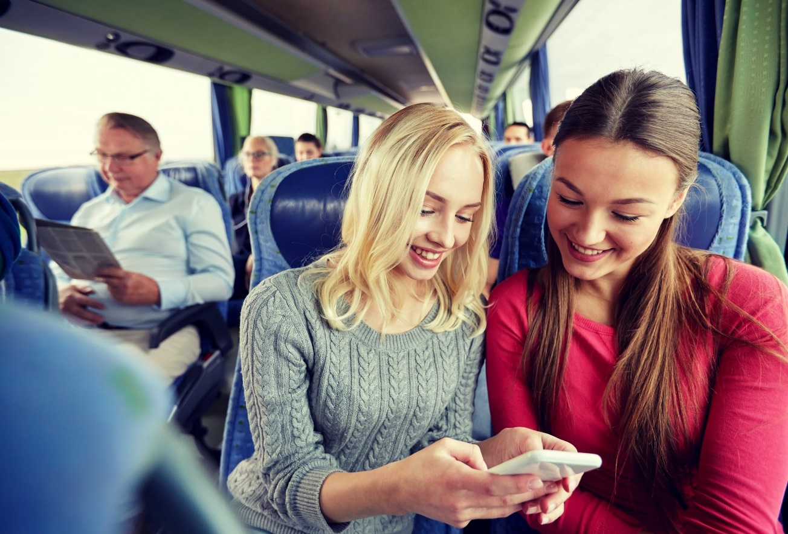
ADVANTAGE:
Reduce the crowed.
Increase the quality of travel.
Helps in the organization of transport system etc..

Slide 10
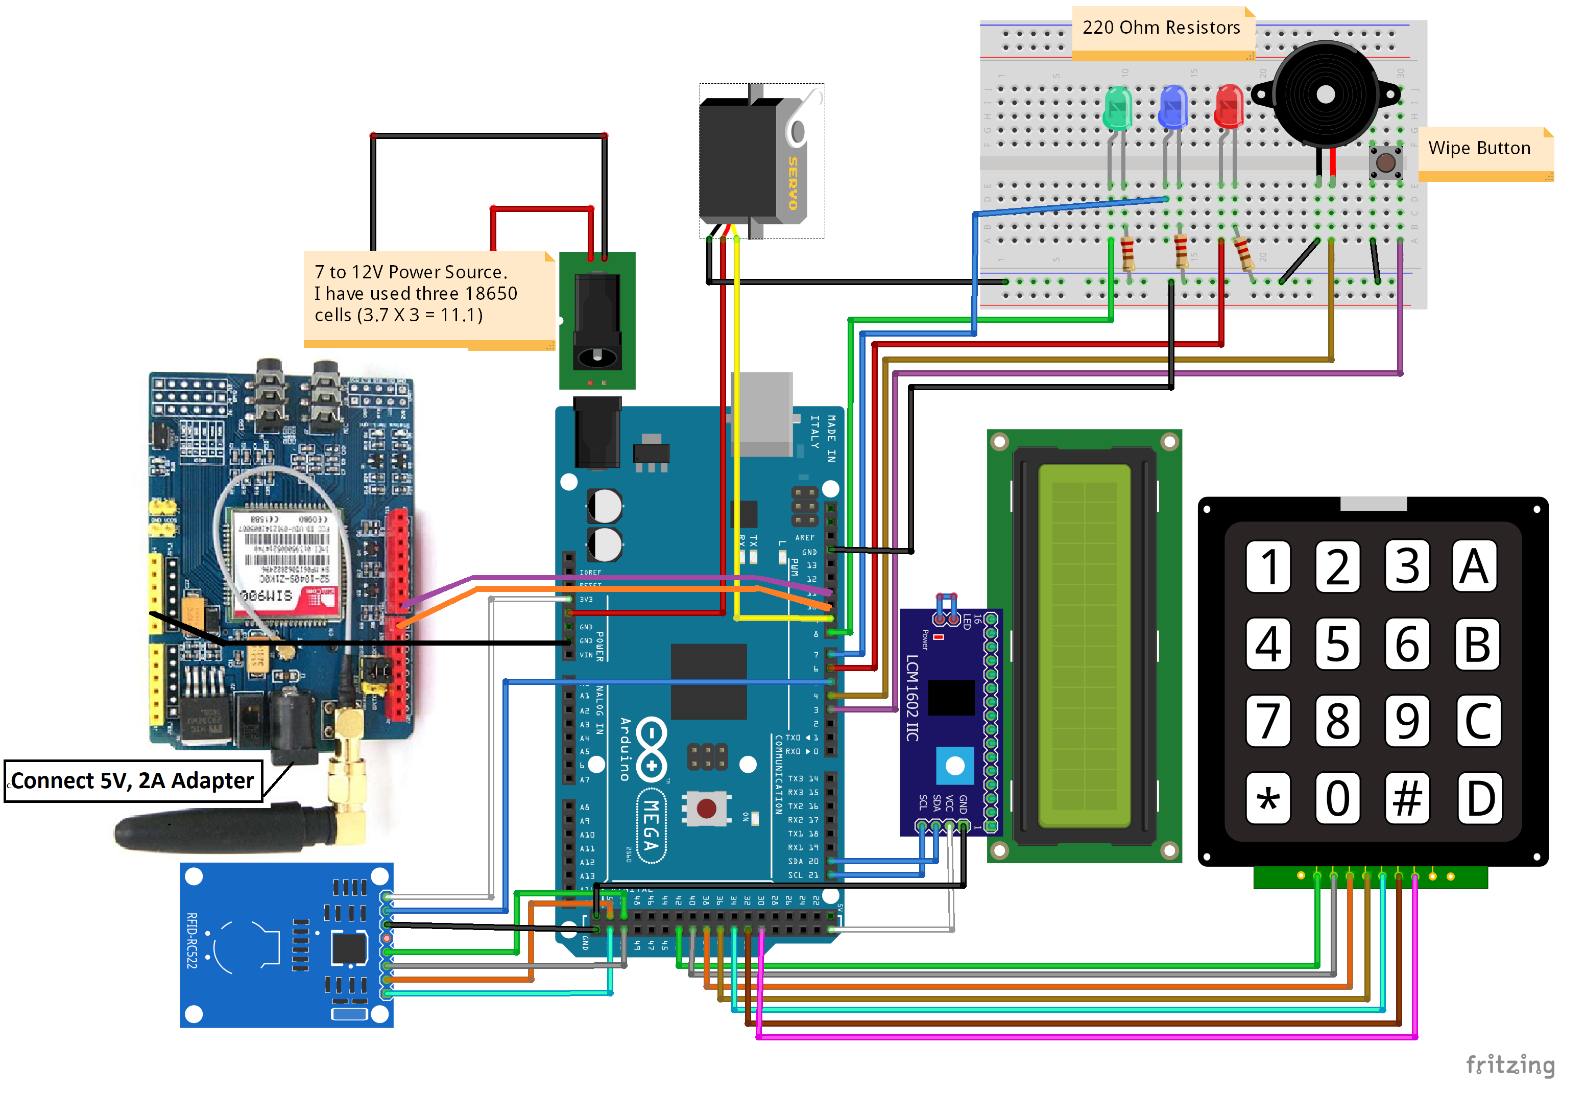
Circuit diagram:

Slide 11


